Slide 1


Inclusive Education in China & Brunei
A 5-Year Comparative Literature Analysis (2021–2026) on Governance, EdTech, Regional Synergies & Mutual Insights

Slide 2

Executive Summary & Research Scope
Macro System Contrast
Regional & Centralized Model
China: Operates a large-scale, multi-tiered framework ("Regular Class Integration" as main body, Special Schools as backbone, Home Teaching as supplement). Serves 435,800 students with special needs under strong central direction, yet regional variations persist.
Brunei: Operates a highly centralized model under the SPN21 framework and MoE AScEND. Capitalizes on standard Malay linguistic synergy with Malaysia and Indonesia (MABBIM) to build low-cost, high-adaptability regional SEN resource networks.

Slide 3

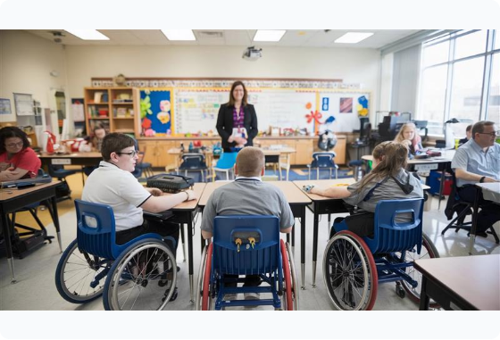
China: Multi-Stakeholder Roles
Government (MoE, CDPF, NHC): Directs top-level 14th 5-Year SEN Plans, funding, resource rooms, and medical-educational integration.
Schools & Resource Teachers: Mainstream schools set up resource rooms for VI, HI, ID, and ASD students, supported by specialized special ed schools.
Universities & Research: Institutions like ECNU and NJSEU drive AI-assistive tool development and empirical pedagogical research.
NGOs & Health System: Provide early childhood intervention and ASD training; hospitals handle medical screening and diagnostic evaluations.

Slide 4

Brunei: Centralized Framework
MoE AScEND Core Leadership
The Special Education Department (AScEND) manages all public school SEN provisions, establishing SENSE (Support Teachers) and SENA (Learning Support Assistants) across 87 Learning Support Centers.
Brunei uses a localized "Priority Levels" framework assessing 5 support domains. Severe disabilities are primarily supported by dedicated NGOs like Pusat Ehsan (Sinaran Pelangi Foundation).

Slide 5

Service Workflow Comparison
Workflow Stage | China Systemic Practice | Brunei Systemic Practice
Screening & Identification | 0–6 Health screening; School health checks; Hospital medical diagnosis. | RIPAS Hospital POVS vision screening; Preschool teacher referral logs.
Assessment & Evaluation | Educational Expert Committees evaluate medical diagnosis & school readiness. | AScEND 5-tier "Priority Levels" evaluation framework; MABBIM tool reuse.
Educational Placement | Tri-pathway: Mainstream class (49.47%), Special School, or Home Delivery. | Mainstream inclusion (majority), 4 Excellence Centers, or NGO Rehab Centers.
In-School Support | Resource Room pull-out support; IEP development; Med-Ed combination. | SENA teaching assistants; SENSE itinerant support; Priority level adaptation.

Slide 6





5-Year Development Trends (2021–2026)
Expansion to Quality
ASD & PBS Priority
Early & Regional SEN
China shifted from basic access to quality inclusion under the 14th Five-Year Plan, prioritizing standardized resource room construction across all counties.
Surge in empirical studies on Autism Spectrum Disorder (ASD), Functional Behavior Assessment (FBA), and Positive Behavior Support (PBS) in mainstream settings.
Brunei emphasized Early Childhood Inclusive Education (ECIE) while deepening regional ASEAN collaboration for specialized learning resources.

Slide 7

EdTech & AI Integration
China: AI & Assistive Innovation
Brunei: Smart Digital Hubs
Development of AI-driven reading tools for visually impaired students (ReadVision), speech synthesis for hearing impairment, VR social training for ASD, and RICE-AI behavioral tracking systems in resource rooms.
Deployment of digital inclusive classrooms supported by MABBIM's regional Malay EdTech platform, delivering digitized multimodal learning materials for learning difficulties and low vision.

Slide 8

Linguistic Synergy: Brunei-Malay Network
Low-Cost Regional Collaboration
90%+
Under the MABBIM language council framework, Brunei leverages shared standardized Malay spelling and grammar. This enables immediate adoption of Malaysian and Indonesian SEN diagnostic batteries, IEP tools, and teacher training curricula at zero translation cost.
Linguistic Intelligibility Across Brunei, Malaysia & Indonesia

Slide 9
Shared Systemic Bottlenecks
IEP Execution Gap: In both nations, Individualized Education Plans often remain administrative paperwork without regular dynamic adjustments or tracking.
Resource Teacher Workload: High student-to-teacher ratios lead to professional burnout among SENA/SENSE staff in Brunei and part-time resource teachers in China.
Severe Disability Coverage: Children with severe/multiple disabilities remain under-supported in regular schools, relying heavily on non-mandatory NGO centers.
Regional Disparities & Data Silos: China faces rural-urban delivery gaps; Brunei lacks detailed national empirical research datasets across disability categories.

Slide 10
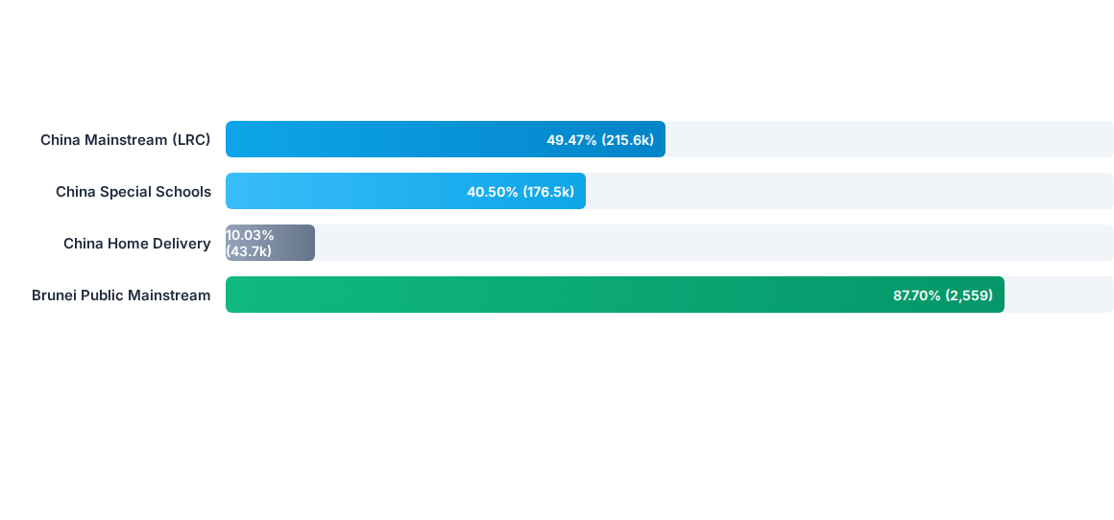
Placement Scale Comparison

Slide 11





Four Bilateral Collaboration Pillars
Joint Teacher Training
Digital Resource Sharing
ASD Behavior Research
Establish China-ASEAN SEN teacher immersion programs leveraging UBD and top Chinese special education universities.
Co-develop multilingual AI assistive tools and digital SEN learning repositories for cross-cultural adaptation.
Collaborate on evidence-based ASD interventions, digital tracking systems, and Positive Behavior Support (PBS).

Slide 12
Questions & Discussion
Towards Inclusive, Equitable, and Technology-Empowered Education in Asia

Slide 13


Image Sources
https://exeedcollege.com/wp-content/uploads/2025/10/Assistive-Technology-in-Special-Education.jpg
Source: exeedcollege.com
https://world-schools.com/wp-content/uploads/2025/07/WSCover-International-School-Brunei.jpg
Source: world-schools.com

